Slide 1
Linear Regression
Prof. Andy Field

Slide 2
Aims
Understand linear regression with one predictor
Understand how we assess the fit of a regression model
Total Sum of Squares
Model Sum of Squares
Residual Sum of Squares
F
R²
Know how to do Regression on IBM SPSS
Interpret a regression model

Slide 3
What is Regression?
A way of predicting the value of one variable from another.
It is a hypothetical model of the relationship between two variables.
The model used is a linear one.
Therefore, we describe the relationship using the equation of a straight line.

Slide 4
Describing a Straight Line
b_{i}
Regression coefficient for the predictor
Gradient (slope) of the regression line
Direction/Strength of Relationship
b₀
Intercept (value of Y when X = 0)
Point at which the regression line crosses the Y-axis (ordinate)

Slide 5
Intercepts and Gradients

Slide 6
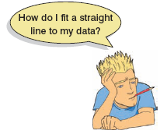
The Method of Least Squares

Slide 7
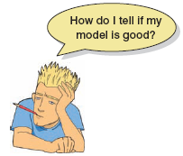
How Good is the Model?
The regression line is only a model based on the data.
This model might not reflect reality.
We need some way of testing how well the model fits the observed data.
How?

Slide 8
Sums of Squares

Slide 9
Summary
SS_{T}
Total variability (variability between scores and the mean).
SS_{R}
Residual/Error variability (variability between the regression model and the actual data).
SS_{M}
Model variability (difference in variability between the model and the mean).

Slide 10
Testing the Model: ANOVA
SS_{T}
Total Variance In The Data
SS_{M}
SS_{R}
Improvement Due to the Model
Error in Model
If the model results in better prediction than using the mean, then we expect SS_{M} to be much greater than SS_{R}

Slide 11
Testing the Model: ANOVA
Mean Squared Error
Sums of Squares are total values.
They can be expressed as averages.
These are called Mean Squares, MS

Slide 12
Testing the Model: R²
R²
The proportion of variance accounted for by the regression model.
The Pearson Correlation Coefficient Squared

Slide 13
Regression: An Example
A record company boss was interested in predicting album sales from advertising.
Data
200 different album releases
Outcome variable:
Sales (CDs and Downloads) in the week after release
Predictor variable:
The amount (in £s) spent promoting the album before release.

Slide 14
Step One: Graph the Data

Slide 15
Regression Using IBM SPSS

Slide 16
Output: Model Summary

Slide 17
Output: ANOVA

Slide 18
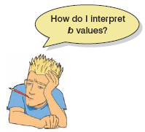
SPSS Output: Model Parameters

Slide 19
Using The Model

